Slide 1
DataScrum
Alt Data Hackathon
14th September, 2019
King Wong
Anthony Gallese
Jia Hu

Slide 2



Team
Anthony Gallese
Product Consultant
King Wong
Data Scientist
HSBC
Jia Hu
Analyst
Neudata

Slide 3
Our goals for this hackathon
Understand various datasets and discover potential relationships between them
Build a market-neutral trading strategy with positive alpha that we can backtest
*backtest means no peeping ahead !

Slide 4
Initial Hypotheses
We wanted to start with a classic pairs trading strategy to neutralize market risk, and augment our strategy with some of the alt data provided.
We hypothesized that by overlaying analyst expectations vs results, we could further improve upon our model.

Slide 5
Our trading pairs
We identified cointegration in the following pairs of stocks in the consumer/ retail sectors using augmented Dicky-Fuller test.
pairs | adfStats (df stat, critical value, log likelihood) | cointegration
('ASOMY_Close', 'TJX_Close') | (-2.6169519163346098, -2.567764970671501}, 7043.669459612164) | TRUE
('GPS_Close', 'JWN_Close') | (-2.8145609016403115, -2.567764970671501}, 3108.1324354539865) | TRUE
('EBAY_Close', 'GPS_Close') | (-3.528752678708312, -2.5677656145911203}, 5375.449834604025) | TRUE
('ASOMY_Close', 'HNNMY_Close') | (-3.288698358231701, -2.567764970671501}, 6473.16358765522) | TRUE
('EBAY_Close', 'URBN_Close') | (-2.633171844362416, -2.5677656145911203}, 5473.874861588272) | TRUE

Slide 6
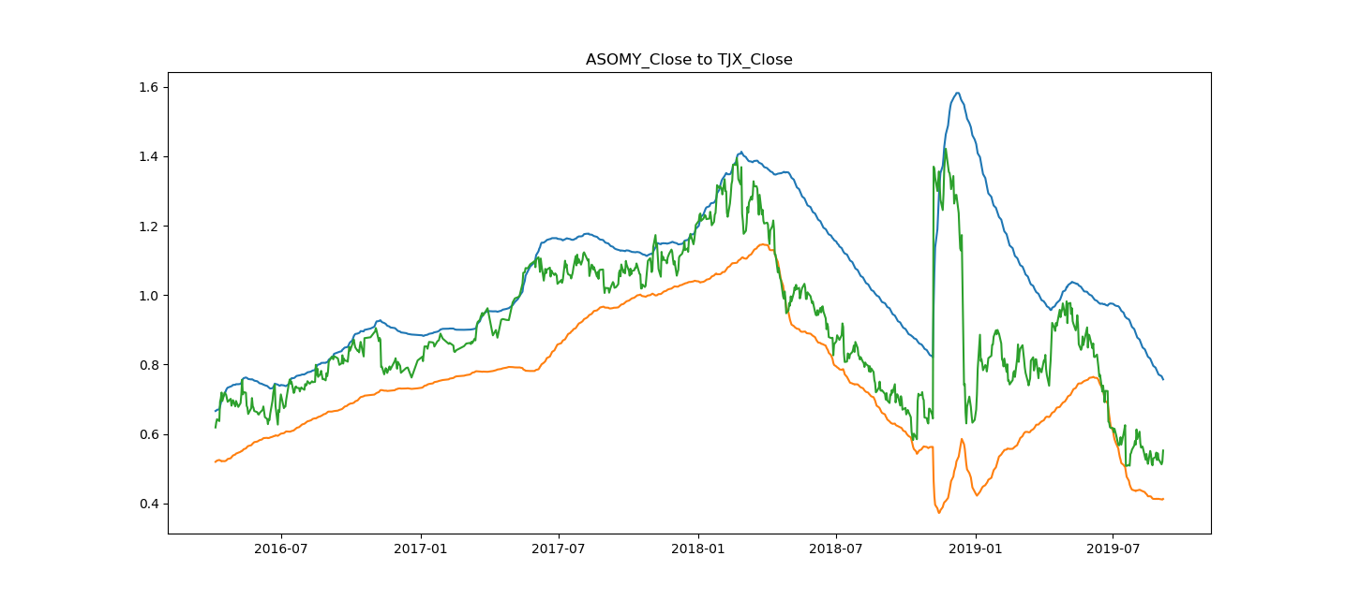
Pure Pairs Trading Strategy with Bollinger Bands

Slide 7
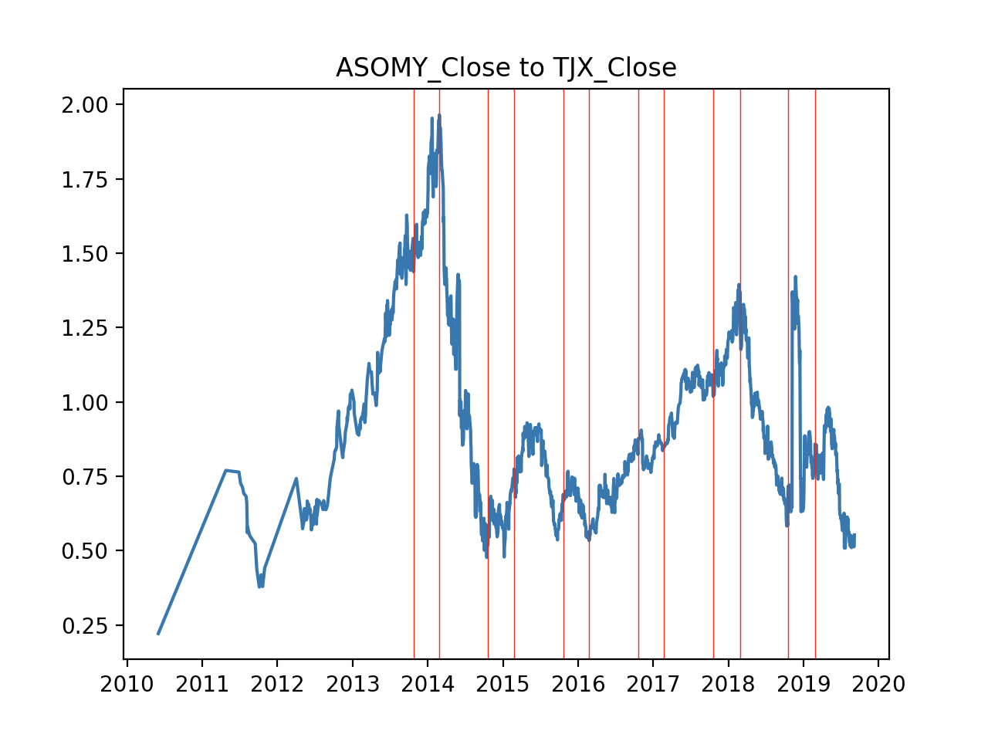
Why do we need alt data?
Pairs ratio will not necessarily be mean-reverting if earnings surprises affect an individual stock.

Slide 8
Signals used
Web traffic and App usage data from Similar Web
Annual actual and estimates report from Refinitiv
Cointegrating pairs Close prices frim OpenData
Unwind pairs trading position and make long/ short bets when near annual report releases
web
desktop_visits
desktop_pages_per_visit
desktop_visit_duration
desktop_bounce_rate
desktop_page_views
mobile_visits
mobile_pages_per_visit
mobile_visit_duration
mobile_bounce_rate
mobile_page_views
total_visits
total_pages_per_visits
total_visit_duration
total_bounce_rate
total_page_views
app
app_name
country_name
Year
Month
Day
current_installs
downloads
usage_time
average_sessions_per_user
daily_active_users
usage_penetration
open_rate
('ASOMY_Close', 'TJX_Close')
('GPS_Close', 'JWN_Close')
('EBAY_Close', 'GPS_Close')
('ASOMY_Close', 'HNNMY_Close')
('EBAY_Close', 'URBN_Close')
*
=> Pivot => Alt signals

Slide 9
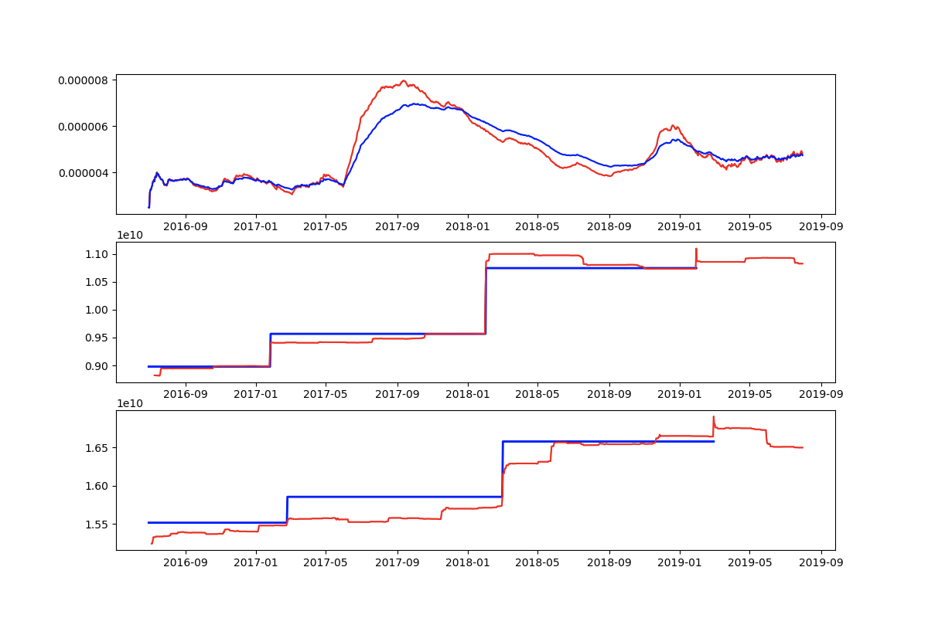
One of many signals
200_100_MA_usage_penetration_TJX US and Revenue Actuals vs Estimates
TP | FP
FN | TN
2 | 1
0 | 0

Slide 10
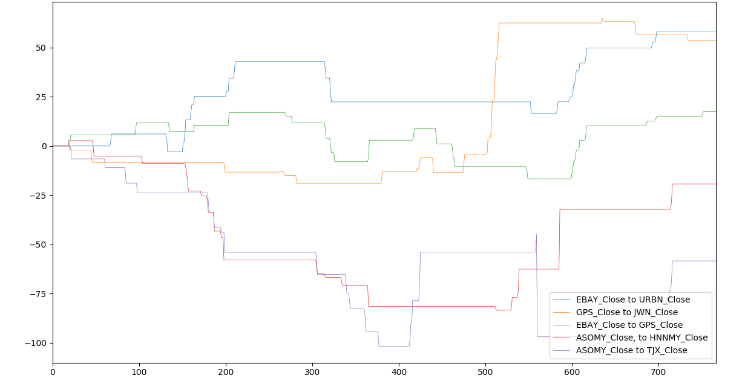
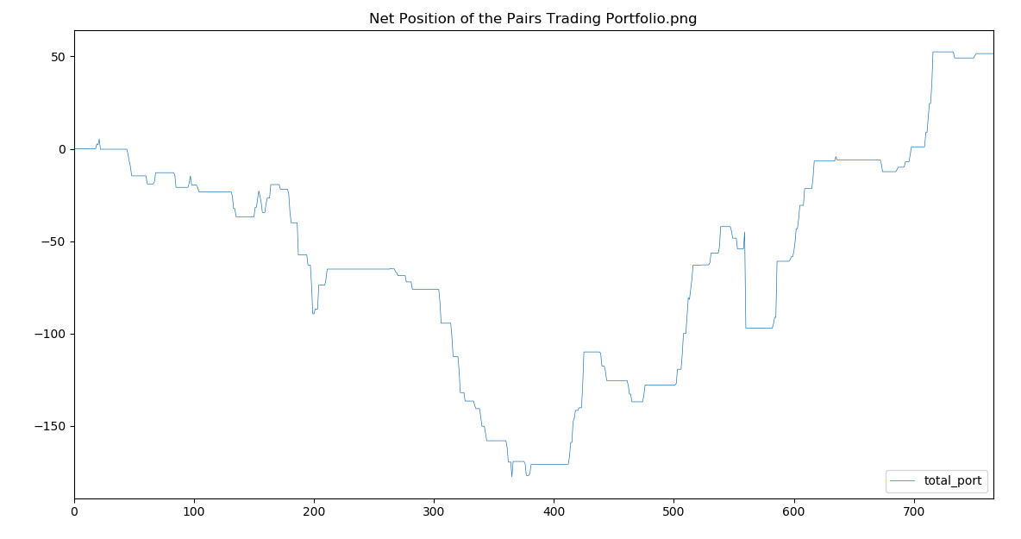
Pure pairs trading strategy

Slide 11
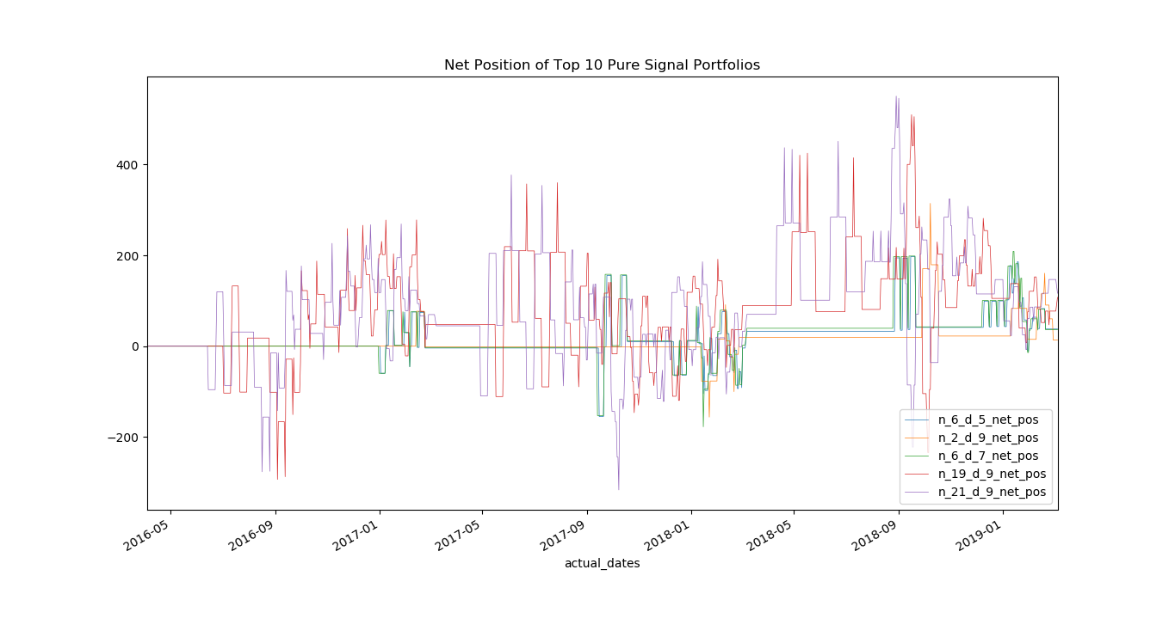
Pairs Trading overlay with Alt Signals

Slide 12
Some annualised return stats…
Pair | Pure pairs trading | Overlaying Strategy | Returns Attributed to Alt Signals | Positive Addition?
('ASOMY_Close', 'TJX_Close') | -0.036576 | -0.02276927 | 0.013806728 | TRUE
('GPS_Close', 'JWN_Close') | 0.021055 | 0.034626013 | 0.013571013 | TRUE
('EBAY_Close', 'GPS_Close') | 0.017112 | 0.030424451 | 0.013312451 | TRUE
('ASOMY_Close', 'HNNMY_Close') | -0.002956 | 0.009529442 | 0.012485442 | TRUE
('EBAY_Close', 'URBN_Close') | 0.080532 | 0.092840883 | 0.012308883 | TRUE

Slide 13
Future Improvements
1. Finding CAUSALTY between Alt Signals and Price Movements
2. Portfolios Sharpe, tearsheets
3. Dynamic entering and exiting position window
4. More cointegrating pairs
5. More data
Happy hacking!
https://github.com/kingwongf/datascrum_hackathon

Slide 14
THANK YOU

